Slide 1
Chapter 7
ADVANCED CSS: LAYOUT

Slide 2
Normal Flow
Normal flow, refers here to how the browser will normally display block-level elements and inline elements from left to right and from top to bottom.
Every HTML element has a default display value, depending on what type of element it is.
The two most common display values are block and inline.
Normal flow is the default way of laying out elements on an HTML page.
In other words, an HTML page is in a normal flow layout when you do nothing to rearrange the default positioning of its elements.

Slide 3
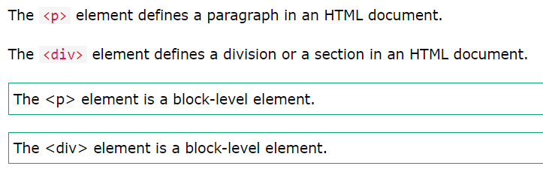
Block-level Elements
A block-level element always starts on a new line, and the browsers automatically add some space (a margin) before and after the element.
A block-level element always takes up the full width available (stretches out to the left and right as far as it can).
Block level elements are displayed from top to bottom.
Two commonly used block elements are: <p> and <div>.

Slide 4
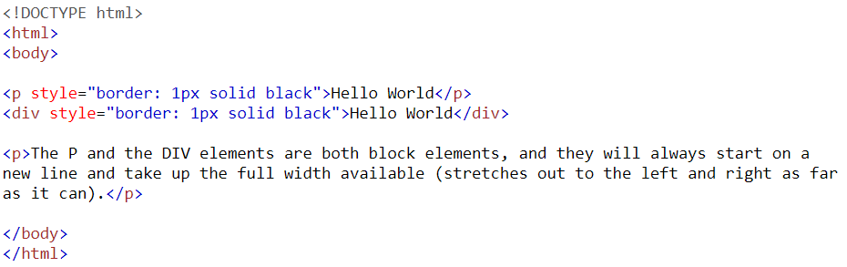
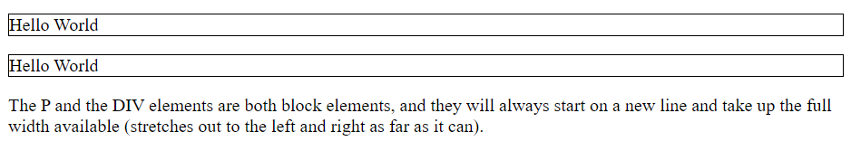

Slide 5
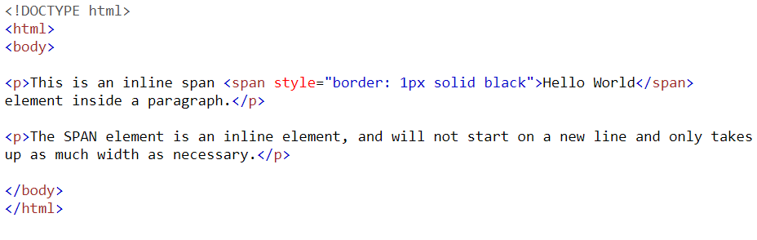
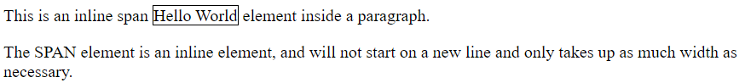
Inline Elements
An inline element does not start on a new line.
An inline element only takes up as much width as necessary.
Inline elements are displayed from left to right.

Slide 6
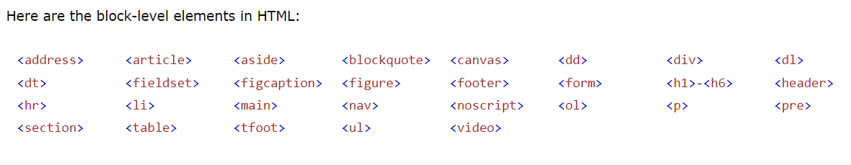
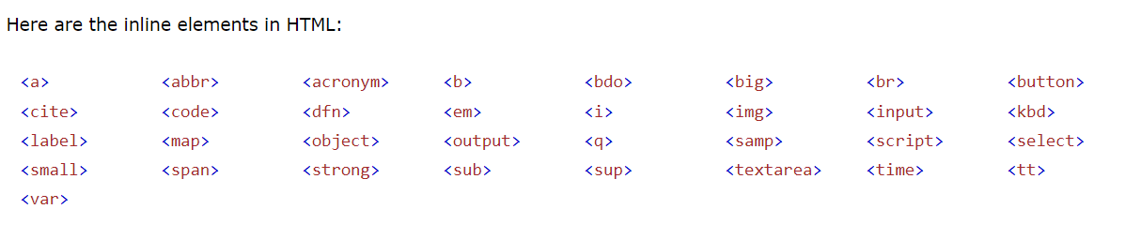

Slide 7
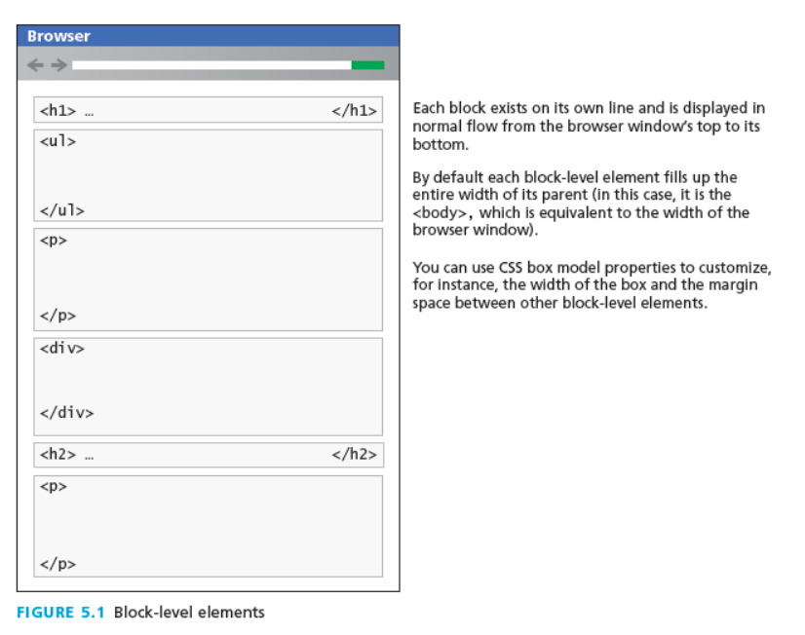

Slide 8
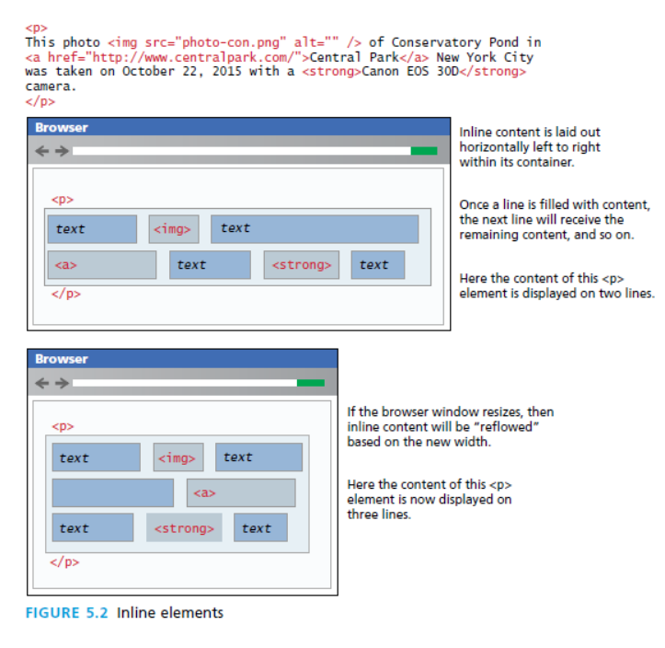

Slide 9
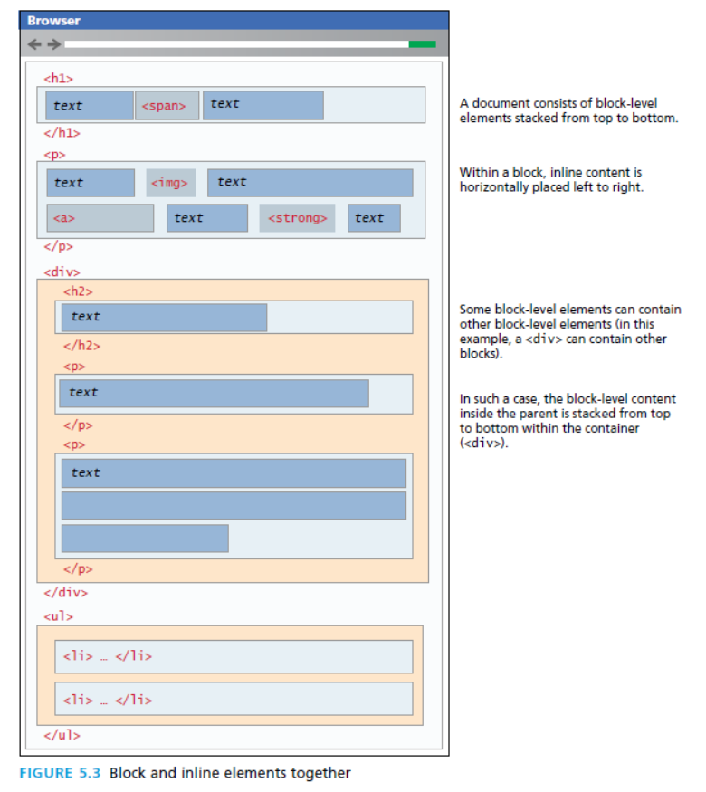

Slide 10
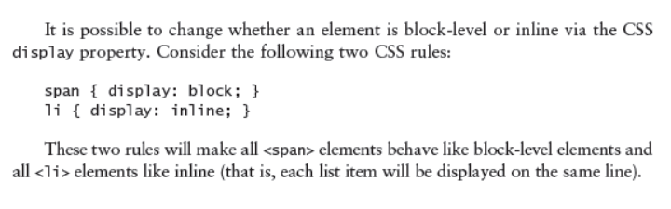
Note:

Slide 11
Advanced CSS: Positioning Elements

Slide 12
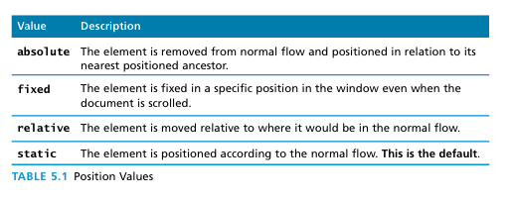
Positioning Elements..
It is possible to move an item from its regular position in the normal flow, and even move an item outside of the browser viewport so it is not visible or to position it so it is always visible in a fixed position while the rest of the content scrolls.
The position property is used to specify the type of positioning.

Slide 13
Relative Positioning
In relative positioning an element is displaced out of its normal flow position and moved relative to where it would have been placed.
When an element is positioned relatively, it is displaced out of its normal flow position and moved relative to where it would have been placed.
The other content around the relatively positioned element “remembers” the element’s old position in the flow; thus the space the element would have occupied is preserved

Slide 14
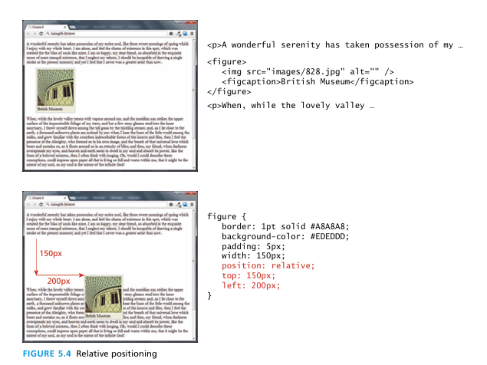
Relative Positioning
As you can see in Figure 5.4, the original space for the positioned element is preserved, as is the rest of the document’s flow. As a consequence, the repositioned element now overlaps other content: that is, the <p> element following the <figure> element does not change to accommodate the moved <figure>

Slide 15
Absolute Positioning
When an element is positioned absolutely, it is removed completely from normal flow.
Thus, unlike with relative positioning, space is not left for the moved element, as it is no longer in the normal flow.
Its position is moved in relation to its container block.

Slide 16
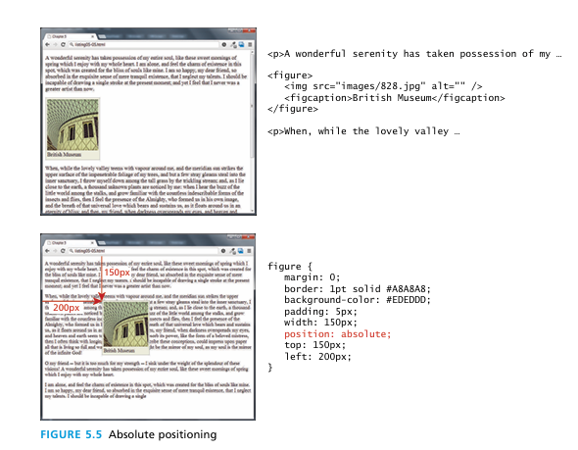
In the example shown in Figure 5.5, the container block is the <body> element. Like with the relative positioning example, the moved block can now overlap content in the underlying normal flow .

Slide 17
Z - index
The z-index property specifies the stack order of an element.
An element with greater stack order is always in front of an element with a lower stack order.
z-index only works on positioned elements (position: absolute, position: relative, position: fixed, or position: sticky) and
flex items (elements that are direct children of display:flex elements).
If two positioned elements overlap without a z-index specified, the element positioned last in the HTML code will be shown on top.

Slide 18
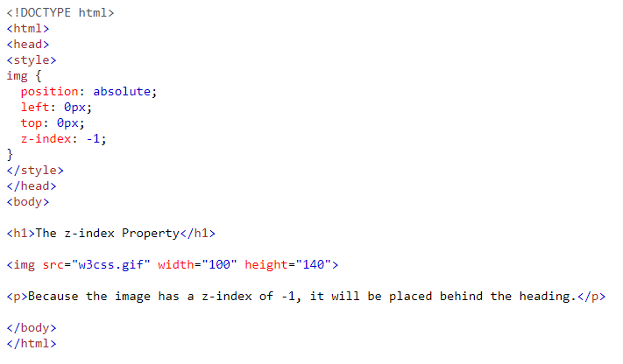
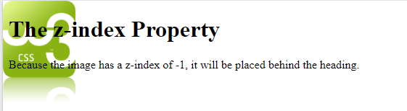
Z - index

Slide 19
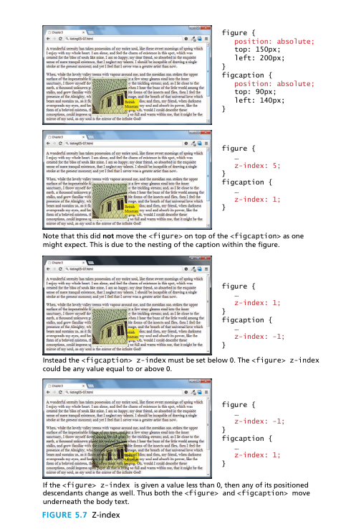

Slide 20
Fixed Position
The fixed position value is used relatively infrequently. It is a type of absolute positioning, except that the positioning values are in relation to the viewport (i.e., to the browser window).
Elements with fixed positioning do not move when the user scrolls up or down the page.
The fixed position is most commonly used to ensure that navigation elements or advertisements are always visible

Slide 21
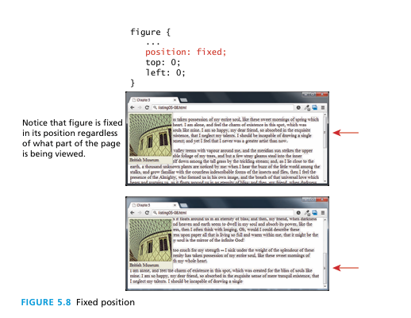
Fixed Position

Slide 22
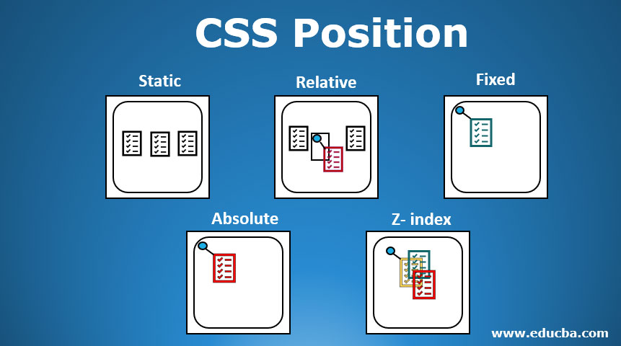

Slide 23
Advanced CSS: Floating Elements

Slide 24
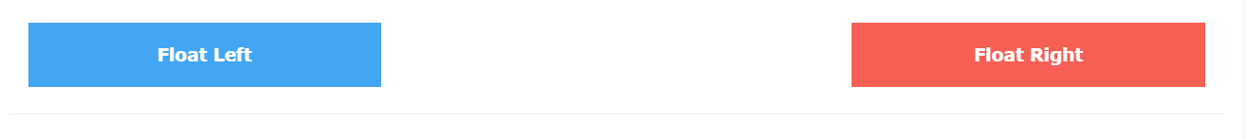
Floating Elements
It is possible to displace an element out of its position in the normal flow via the CSS float property.
An element can be floated to the left or floated to the right.
When an item is floated, it is moved all the way to the far left or far right of its containing block and the rest of the content is “re-flowed” around the floated element.

Slide 25
Floating Elements
The float property is used for positioning and formatting content e.g. let an image float left to the text in a container.
The float property can have one of the following values:
left - The element floats to the left of its container
right - The element floats to the right of its container
none - The element does not float (will be displayed just where it occurs in the text). This is default
inherit - The element inherits the float value of its parent
In its simplest use, the float property can be used to wrap text around images.

Slide 26
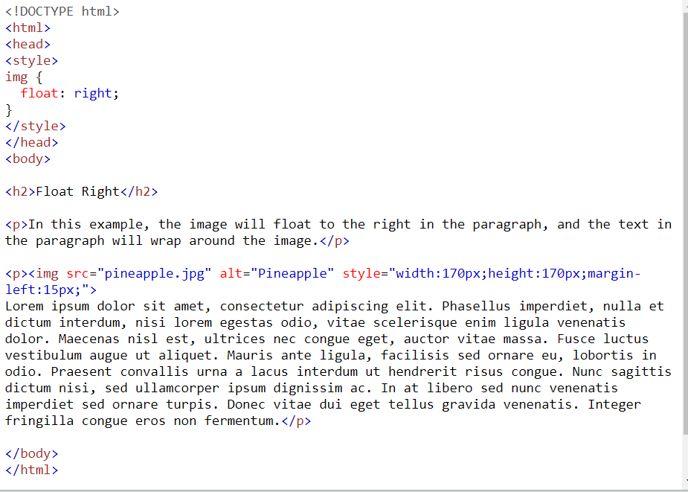

Slide 27
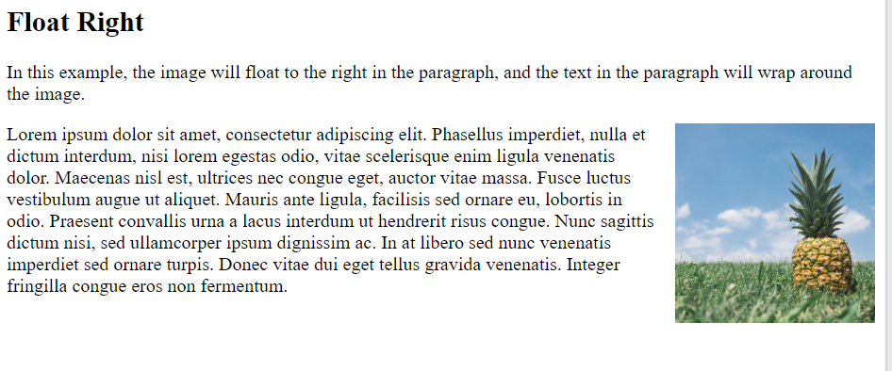

Slide 28
Floating within a Container
It should be reiterated that a floated item moves to the left or right of its container (also called its containing block).
In Figure 5.9, the containing block is the HTML document itself so the figure moves to the left or right of the browser window.
But in Figure 5.10, the floated figure is contained within an element that is indented from the browser’s edge.
The relevant margins and padding areas are color coded to help make it clearer how the float interacts with its container.

Slide 29
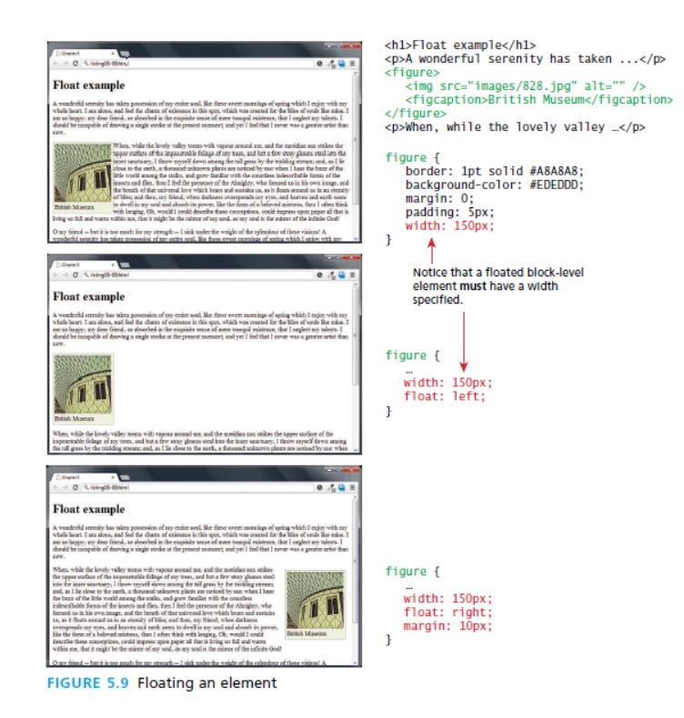

Slide 30
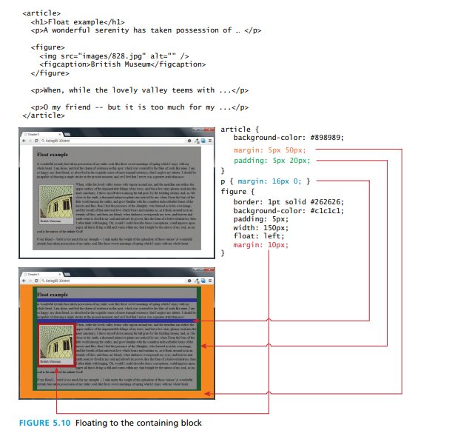

Slide 31
Floating Multiple Items side-by-side
One of the more common usages of floats is to place multiple items side by side on the same line.
When you float multiple items that are in proximity, each floated item
in the container will be nestled up beside the previously floated item.
All other content in the containing block (including other floated elements) will flow around all the floated elements

Slide 32
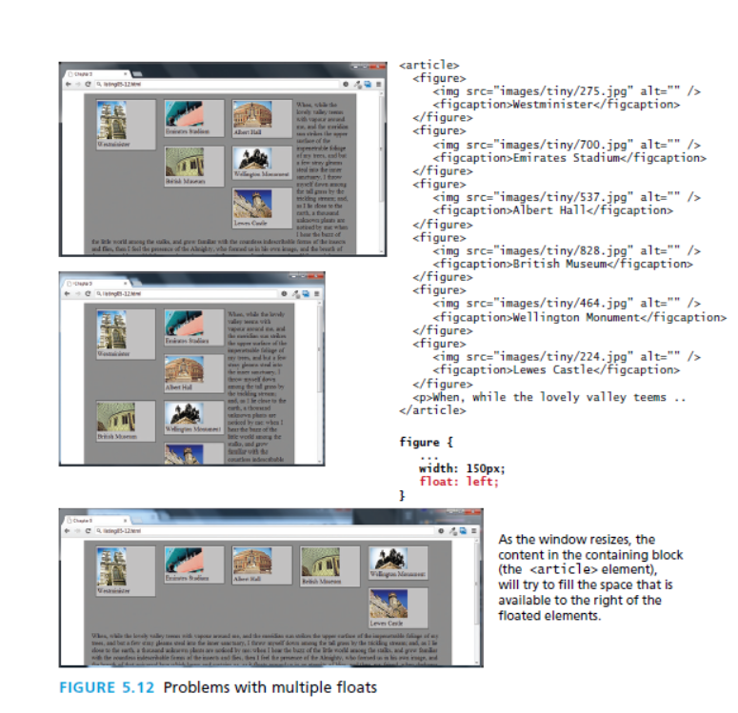

Slide 33
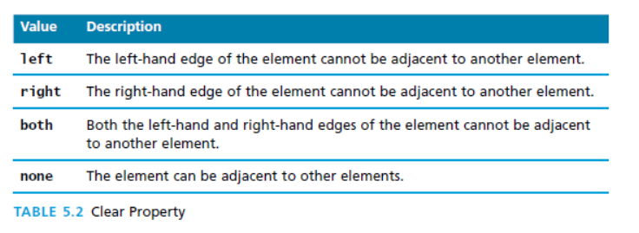
Clear Property
You can stop elements from flowing around a floated element by using the clear property.
The clear property specifies what should happen with the element that is next to a floating element.
When clearing floats, you should match the clear to the float: If an element is floated to the left, then you should clear to the left. Your floated element will continue to float, but the cleared element will appear below it on the web page.

Slide 34
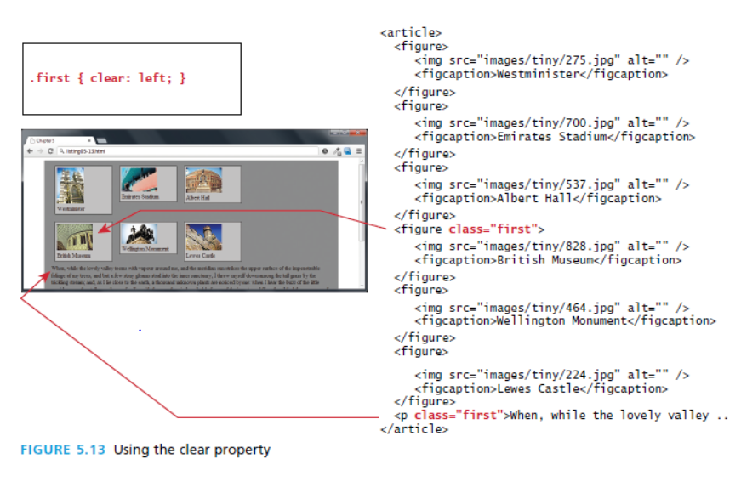

Slide 35
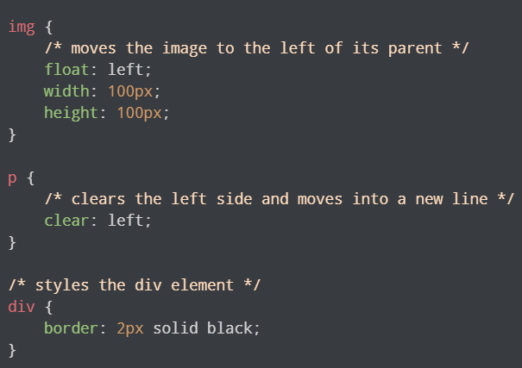
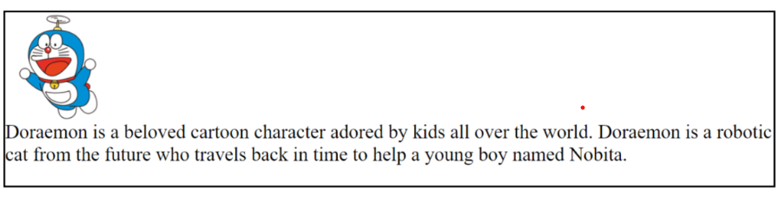

Slide 36
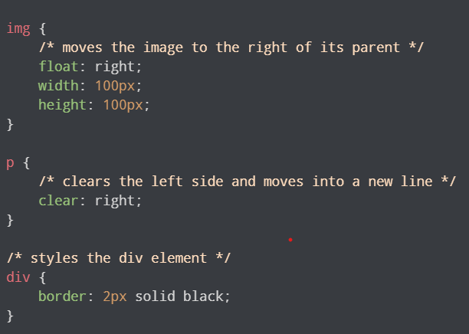
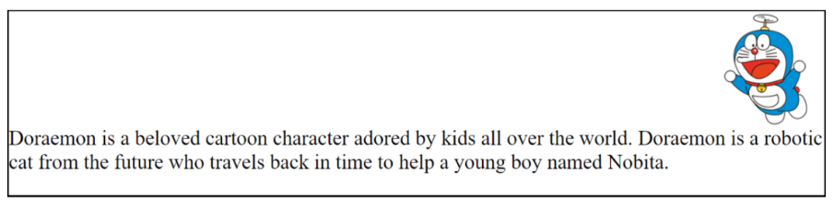

Slide 37
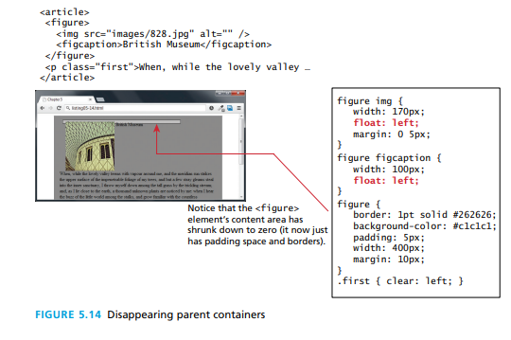
Containing floats
Another problem that can occur with floats is when an element is floated within a containing block that contains only floated content. In such a case, the containing block essentially disappears, as shown in Figure 5.14.
A better solution would be to use the overflow property as shown in Figure 5.15.

Slide 38
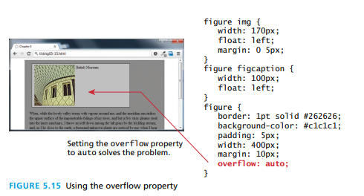
In Figure 5.14, the <figure> containing block contains only an <img> and a <figcaption> element, and both of these elements are floated to the left.
That means both elements have been removed from the normal flow; from the browser’s perspective, since the <figure> contains no normal flow content, it essentially has nothing in it, hence it has a content height of zero.
One solution would be to float the container as well, but depending on the layout this might not be possible.

Slide 39
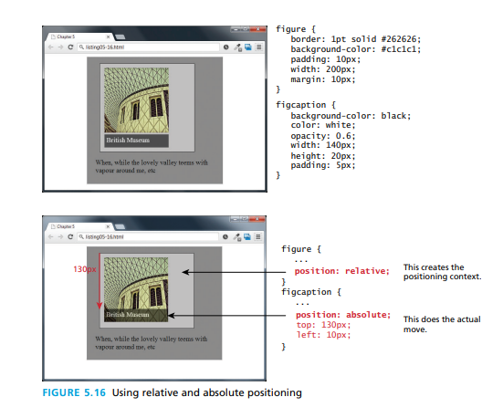
Overlaying and Hiding Elements
One of the more common design tasks with CSS is to place two elements on top of each other, or to selectively hide and display elements.
Positioning is important to both of these tasks.
Positioning is often used for smaller design changes, such as moving items relative to other elements within a container.
In such a case, relative positioning is used to create the positioning context for a subsequent absolute positioning move.

Slide 40
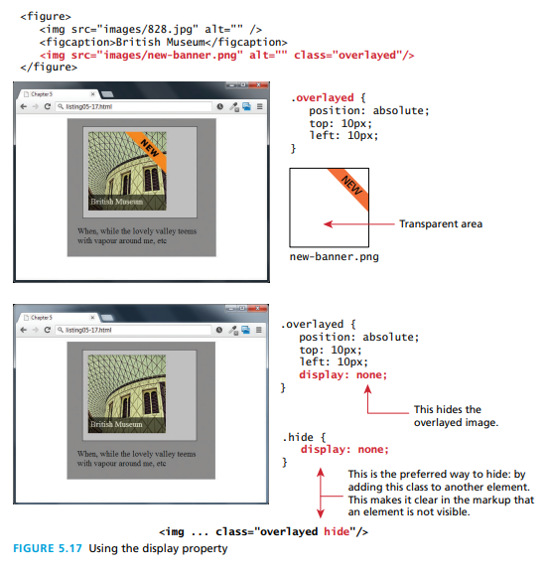

Slide 41
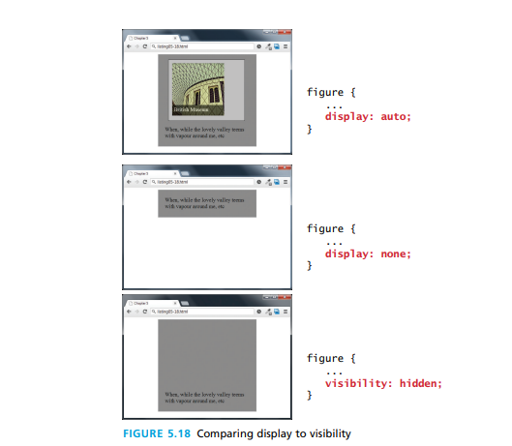

Slide 42
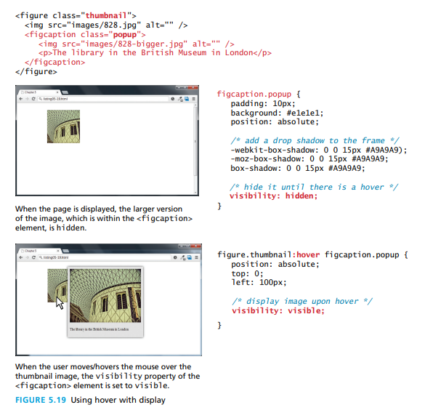

Slide 43
Approaches to CSS Layout
Fixed Layout
In a fixed layout , the basic width of the design is set by the designer, typically corresponding to an “ideal” width based on a “typical” monitor resolution.
The advantage of a fixed layout is that it is easier to produce and generally has a predictable visual result.
Notes:
Fixed layouts are created using pixel units

Slide 44
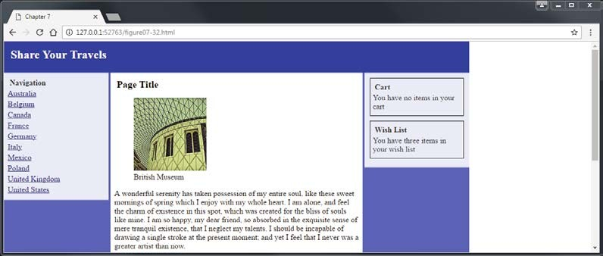
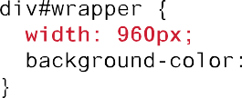
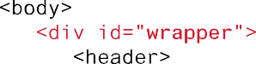
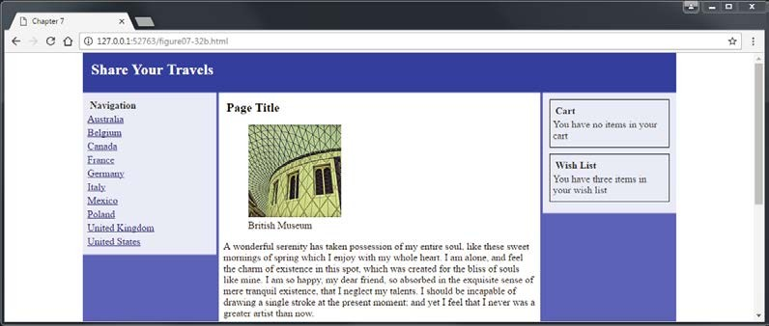
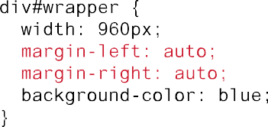

Approaches to CSS Layout
Fixed Layout
Notes:
If we use fixed layout, then it will be messy-if we use smaller screen size and it looks stretched if the window size is larger.

Slide 45
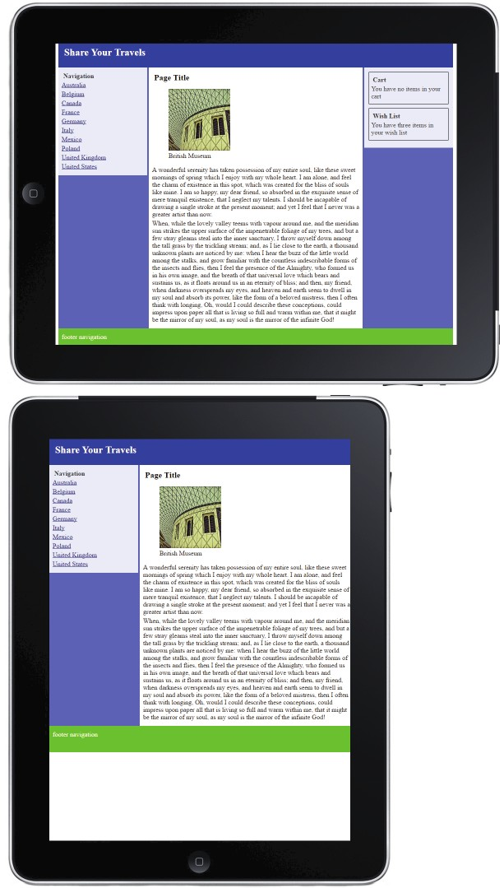
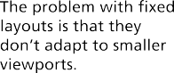
Approaches to CSS Layout
Problem with Fixed Layout

Slide 46
Approaches to CSS Layout
Liquid Layout
Liquid layout (also called a fluid layout) widths are not specified using pixels, but percentage values
The advantage of a liquid layout is that it adapts to different browser sizes
Creating a usable liquid layout is generally more difficult than creating a fixed layout

Slide 47
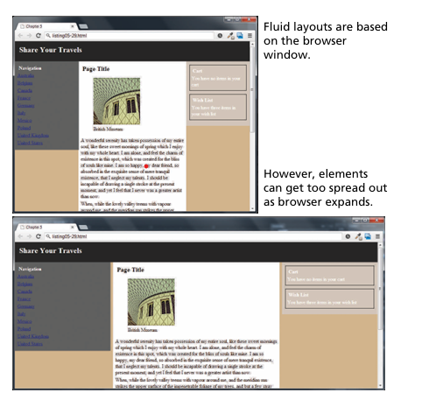
Approaches to CSS Layout
Liquid Layout

Slide 48
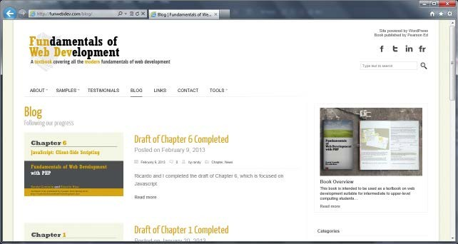
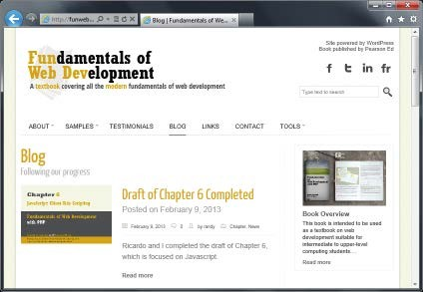
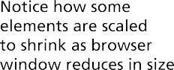
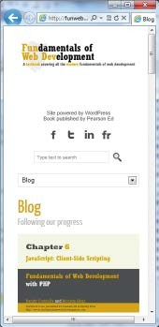
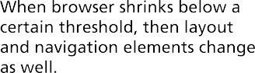

Responsive Design
Responsive Layouts

Slide 49
Responsive Design
4 elements
4 Key components that make responsive design work
Liquid layouts
Scaling images to the viewport size
Setting viewports via the <meta> tag
Customizing the CSS for different viewports using media queries

Slide 50













Responsive Design
Setting Viewports

Slide 51













Responsive Design
Setting Viewports
Notes:
<meta name=“viewport” content=“width=device-width”/> -> setting the viewport

Slide 52


Responsive Design
Media Queries
A media query is a way to apply style rules based on the medium that is displaying the file
Notes:
The @media rule, introduced in CSS2, made it possible to define different style rules for different media types.
Media queries in CSS3 extended the CSS2 media types idea: Instead of looking for a type of device, they look at the capability of the device.
Media queries can be used to check many things, such as:
width and height of the viewport
orientation of the viewport (landscape or portrait)
resolution

Slide 53


99

Slide 54
Responsive Design
Media Queries
width: Width of the viewport
height: Height of the viewport
device-width: Width of the device
device-height: Height of the device
orientation: Whether the device is portrait or landscape
color: The number of bits per color

Slide 55








Responsive Design
Media Queries

Slide 56


Slide 57
CSS Frameworks
A CSS framework is a precreated set of CSS classes or other software tools that make it easier to use and work with CSS. They are two main types of CSS framework: grid systems and CSS preprocessors
Grid system
Grid systems make it easier to create multicolumn layouts. There are many CSS grid systems; some of the most popular are Bootstrap (twitter.github.com/bootstrap), Blueprint (www.blueprintcss.org
Notes:
Bootstrap is a powerful, feature-packed frontend toolkit. Build anything—from prototype to production

Slide 58





CSS Frameworks and Preprocessors
Grid in print design

Slide 59
CSS Frameworks and Preprocessors
Using Bootstrap
<head>
<link href="bootstrap.css” rel="stylesheet">
</head>
<body>
<div class="container">
<div class="row">
<div class="col-md-2"> left column
</div>
<div class="col-md-7"> main content
</div>
<div class="col-md-3"> right column
</div>
</div>
</div>
</body>

Slide 60
CSS Preprocessors
CSS preprocessors are tools that allow the developer to write CSS that takes advantage of programming ideas such as variables, inheritance, calculations, and functions.
A CSS preprocessor is a tool that takes code written in some type of preprocessed language and then converts that code into normal CSS.
The advantage of a CSS preprocessor is that it can provide additional functionalities that are not available in CSS

Slide 61

CSS Preprocessors

